Slide 1
Stock price predictor
Abhishek Nimmakayala
Saurav Mainali

Slide 2
Data set description
The data set is obtained from kaggle, but originally scraped from yahoo finance
Source data is contained in four different CSV files
Data is available for 501 stocks from the years 2010 to 2016
Notes:
Explain the 4 Csv files what they contain
Why you used adjusted price split instead of prices csv
Not evry stock will have data from 2010 to 2016

Slide 3
Pre Processing and Feature engineering
Handled missing values in stock fundamentals data
Created new features to derive insights from data
Merged the data across the different sources to perform exploratory data analysis
Notes:
Created new columns per_chg, start date, end date, total per chg.
How you merged different csv and what columns you pulled from each csv

Slide 4
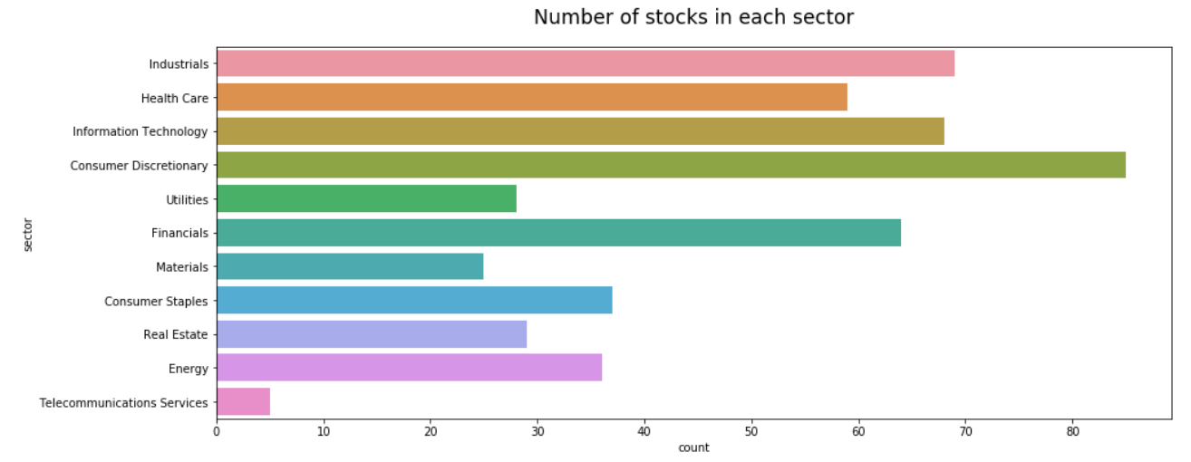
Exploratory data analysis
Notes:
Total of 11 sectors
We have at least 30 stocks in each sector
Highest and lowest stocks in each sector

Slide 5
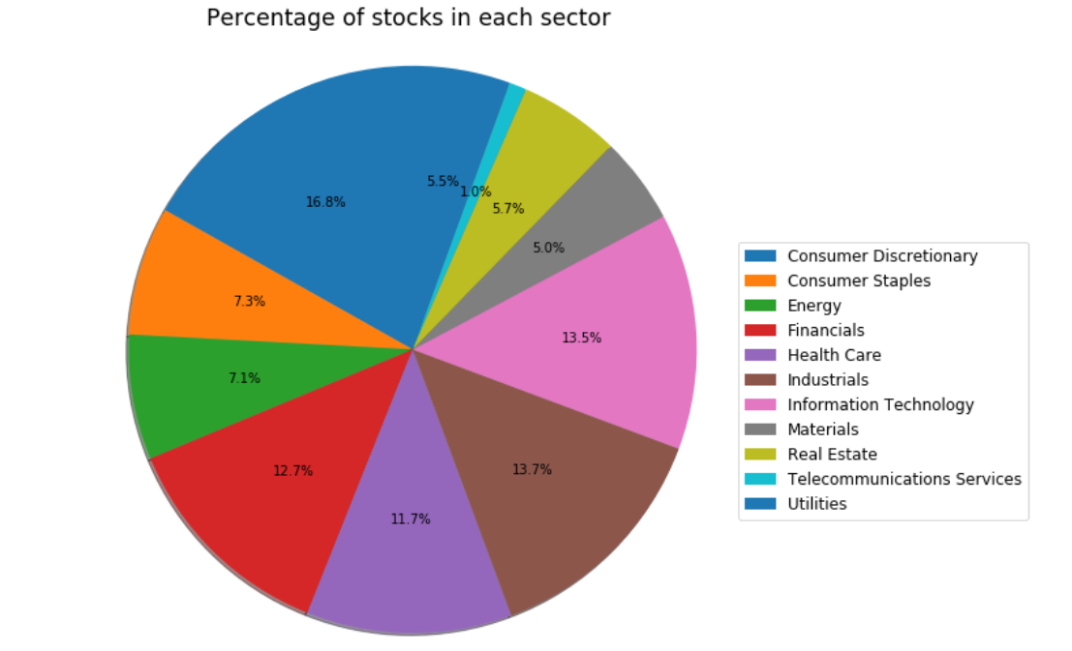
Exploratory data analysis contd.
Notes:
Out of the 501 stocks this is how it’s divided
With insurer descretinaru , IT ,industrials and financials sectors having the highest number of stocks and contribute to 55% of the total stocks

Slide 6
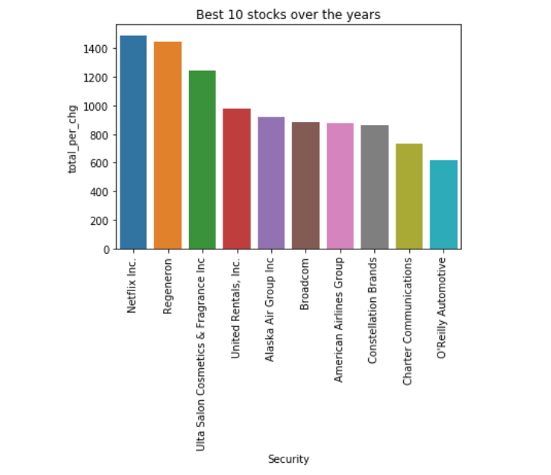
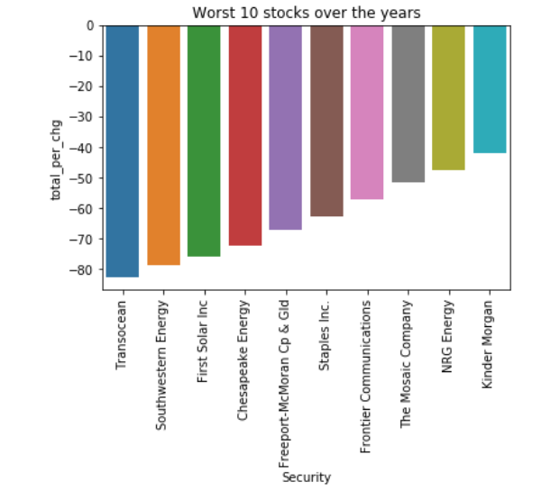
Exploratory data analysis contd.
Notes:
1st takeaway here….long term investment pays of..
Do your research and be patient..

Slide 7
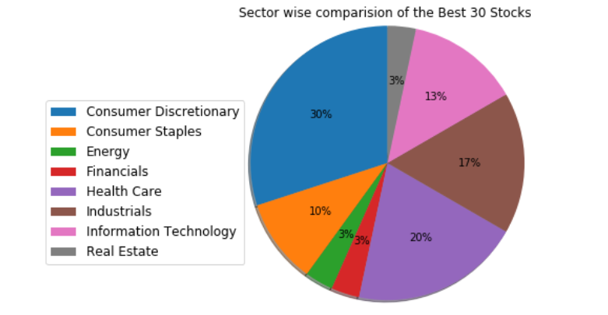
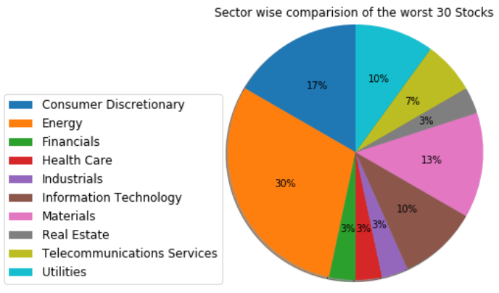
Exploratory data analysis contd.

Slide 8
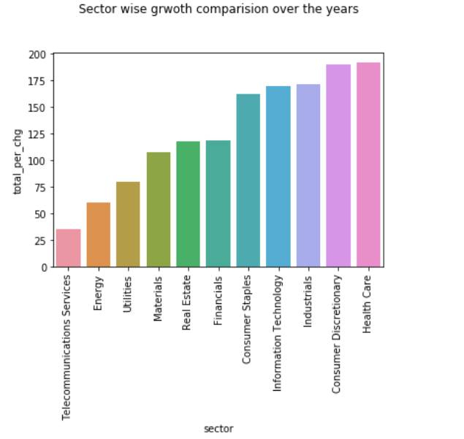
Exploratory data analysis contd.

Slide 9
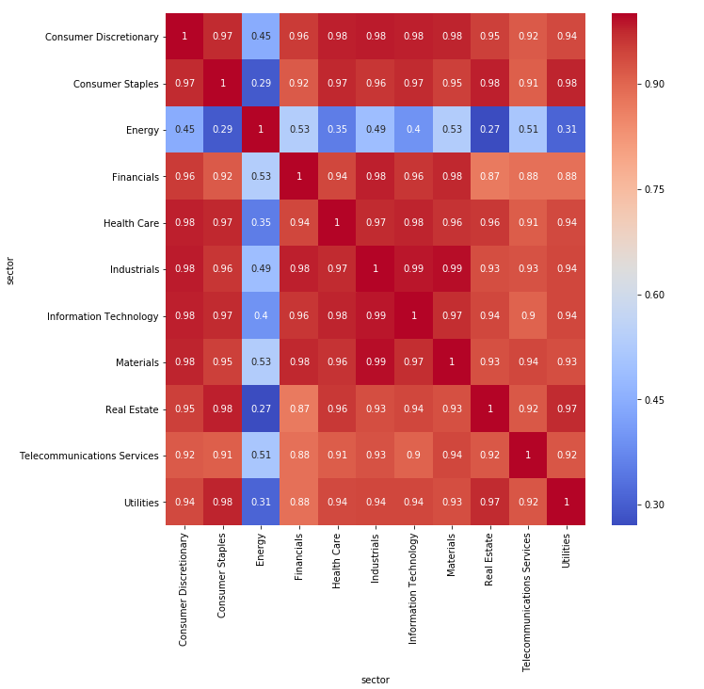
It is always good to diversify your portfolio, to minimize risk

Slide 10
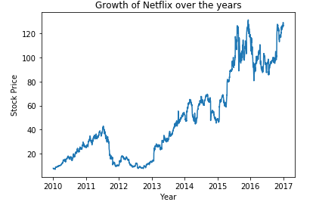
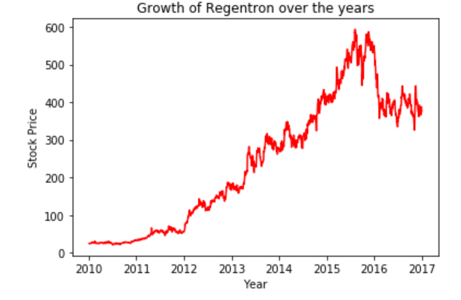
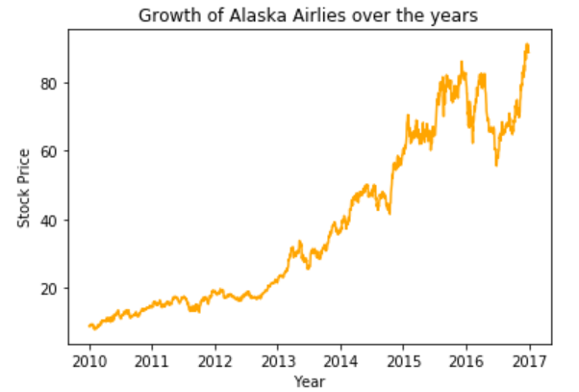
Patience is key

Slide 11
Features and Targets
Features:
Day
Month
Symbol - Stock Name
Open
High
Low
Volume
Target:
Change = % change (close - open) → Positive - Increase
Negative - Decrease

Slide 12
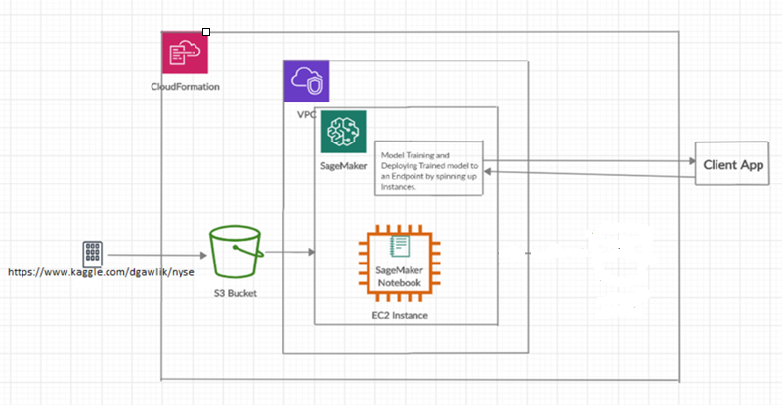
AWS Architecture

Slide 13
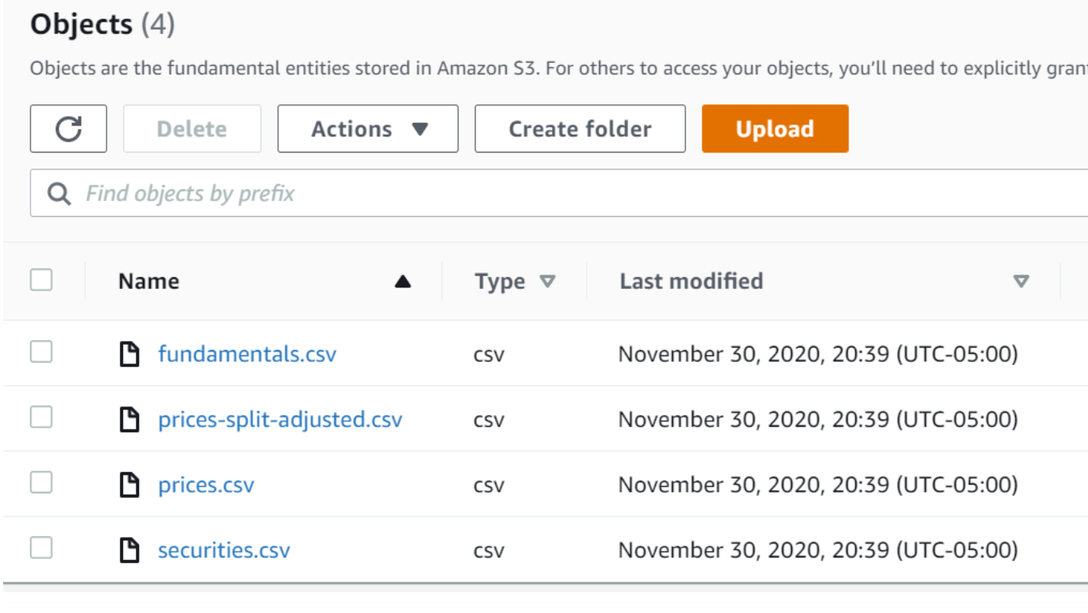
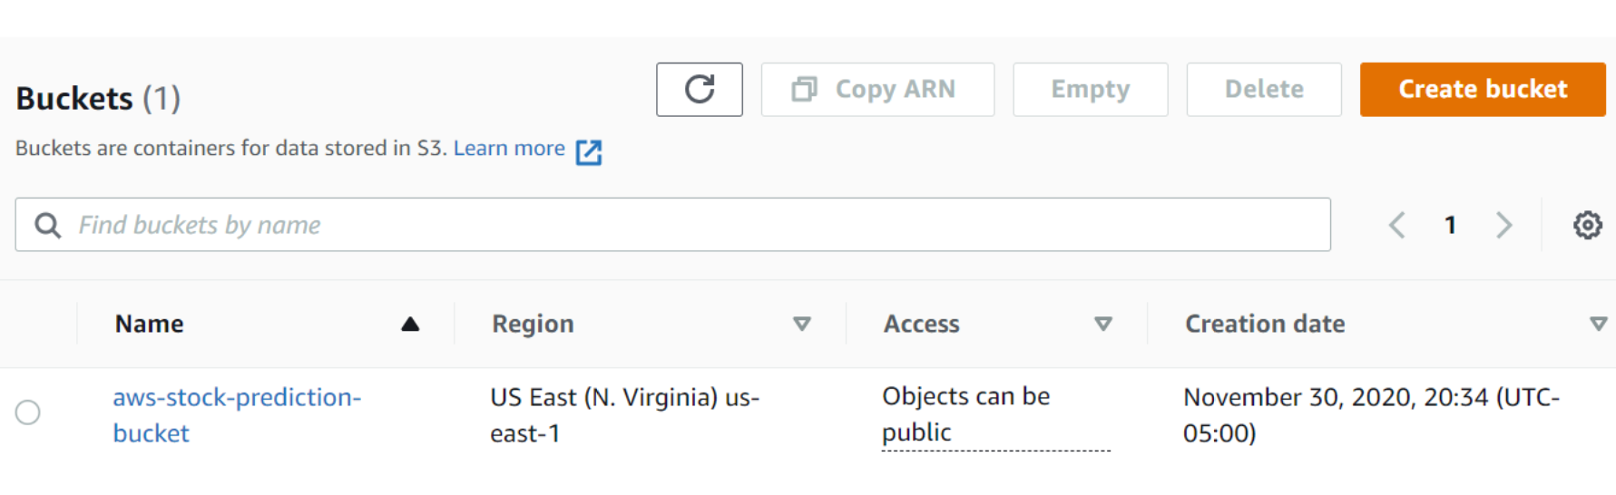
S3 Buckets

Slide 14
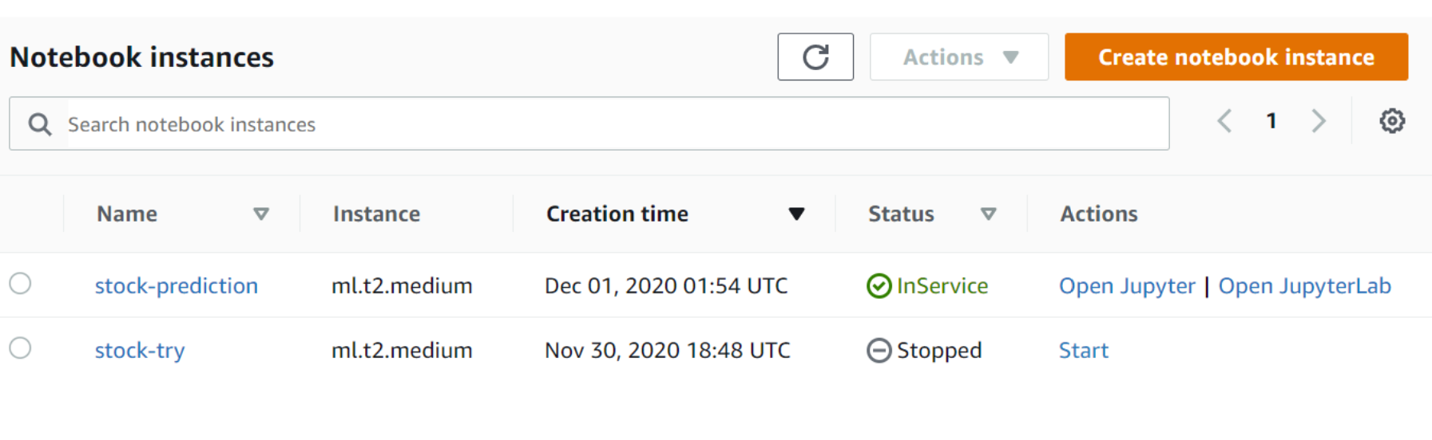
SageMaker Instance

Slide 15
Modelling
Logistic Regression
Decision Tree
Random Forest
Multi-layer perceptron
xgboost

Slide 16
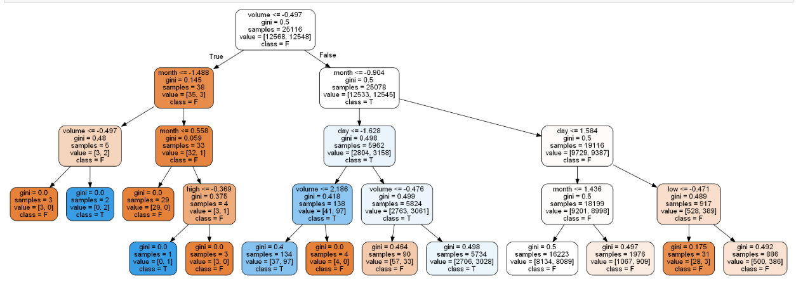
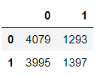
Decision Tree
CV score: 51.29%
Accuracy on Testset:
50.87%
Confusion matrix:
Hyper Parameter tuning:
Best Parameter :
Sample leaf min - 1
Sample split - 2
CV Score : 58.27%

Slide 17
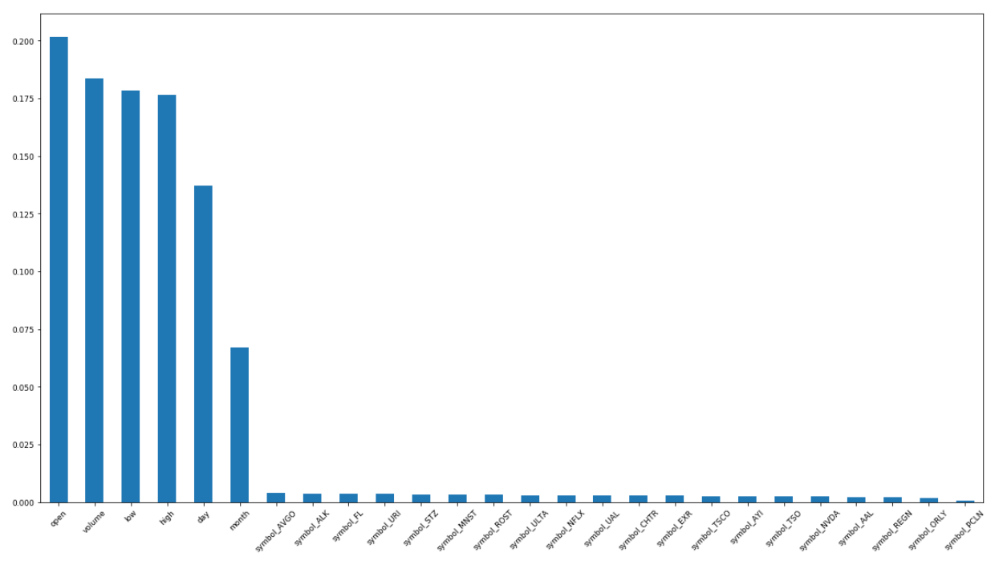
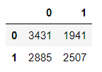
Random Forest
CV score: 54.26%
Accuracy on Testset:
55.16%
Confusion matrix:
Hyper Parameter tuning:
Best Parameter :
Sample leaf min - 1
Sample split - 2
N_estimators - 1000
CV Score : 56.77%

Slide 18

Logistic Regression
Best Parameter :
C - 10000
Solver - Newton-cg
Confusion Matrix :
CV Score : 84.16%
Test Accuracy : 84.15%

Slide 19
Model Comparison
Model Name | Hyper Parameter | CV Score
Logistic Regression | C - 10000 Solver - Newton-cg | 84.16%
Random Forest | Sample leaf min - 1 Sample split - 2 N_estimators - 1000 | 56.77%
Decision Tree | Sample leaf min - 1 Sample split - 2 | 58.27%
XG Boost | eta - 0.0001 gamma - 0 lamda - 0.0001 | 56.25%
MLP | Activation : tanh Hidden_layer_sizes - 100 | 53.76%

Slide 20
Conclusion
Logistic Regression - Best Accuracy - 84%
Features with highest predicting power Open & volume
Sector with the highest growth rate was Healthcare & Consumer discretionary

